Slide 1
Creating a React Front End
Creating a simple React app
Working with components

Slide 2
1. Creating a Simple React App
Recap our technology stack
How to create a React app
Reviewing the React app
The home page
The source code entry point
The App component
Running the application

Slide 3
Recap our Technology Stack
Web
UI
Web
server
application
Database
REST
SQL
React and
HTML, TS, CSS
Java and
Spring Boot
3

Slide 4
How to Create a React App
There are various tools available to create a React app
We're going to use Create React App
See https://create-react-app.dev/
You can create a React app as follows:
Creates a simple React app in TypeScript
Downloads React libraries to the node_modules folder
npx create-react-app my-demo-app --template typescript
4

Slide 5
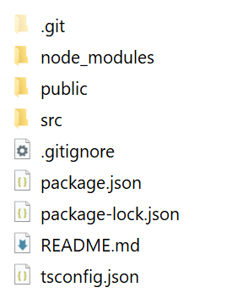
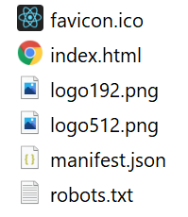
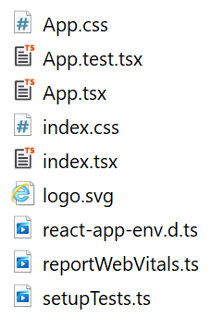
Reviewing the React App
Here's the structure of the generated React app:
public folder
src folder
5

Slide 6
The Home Page
The application home page is public/index.html
<!DOCTYPE html>
<html lang="en">
<head>
<title>React App</title>
…
</head>
<body>
<div id="root"></div>
</body>
</html>
This is where your React content will be added
public/index.html
6

Slide 7
The Source Code Entry Point
The source code entry point is src/index.tsx
Aside: For info about React "strict mode", see:
https://reactjs.org/docs/strict-mode.html
import React from 'react';
import ReactDOM from 'react-dom';
import './index.css';
import App from './App';
…
ReactDOM.render(
<React.StrictMode>
<App />
</React.StrictMode>,
document.getElementById('root')
);
This creates an App component (see next slide)
src/index.tsx
7

Slide 8
The App Component
App is a "functional component"
i.e. a function that returns HTML (XML actually ☺)
import React from 'react';
import './App.css';
…
function App() {
return (
<div className="App">
<header className="App-header">
<img src={logo} className="App-logo" alt="logo" />
… Plus other HTML content …
</header>
</div>
);
}
export default App;
A .tsx file is a mixture of TypeScript and XML
src/App.tsx
8

Slide 9
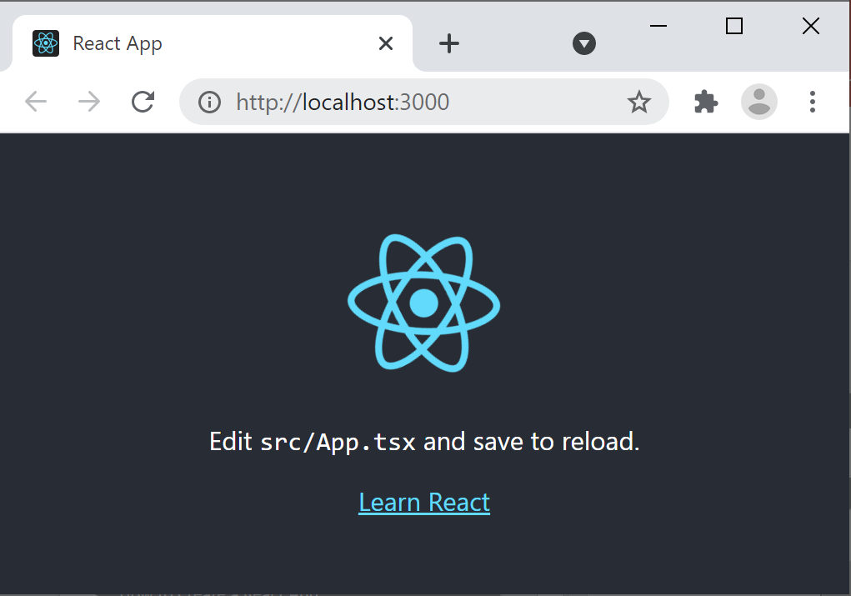
Running the Application
You can run the application as follows:
Builds the app in memory
Starts a server to host app on http://localhost:3000
npm start
9

Slide 10
2. Working with Components
Overview
Defining and instantiating a component
Passing a property to a component
Passing multiple properties
Working with complex data
React demo: demo-react-app2
To install: npm install
To run: npm start

Slide 11
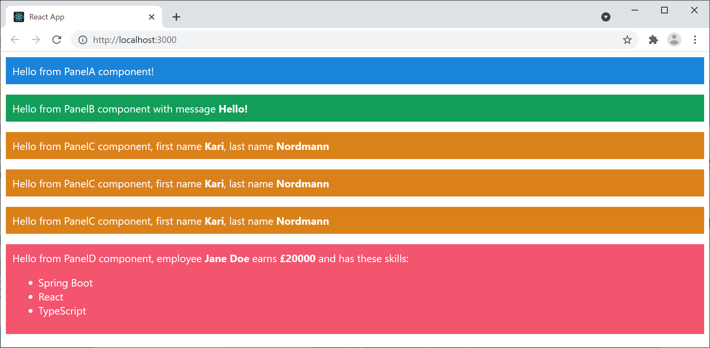
Overview
Let's see a React app that has multiple components
The root component, named <App>
Plus other components, to render portions of HTML
11

Slide 12
Defining and Instantiating a Component
Define a component as a function that returns markup:
Instantiate the component wherever you need it:
export default function PanelA() {
return (
<div className="panelA">
Hello from PanelA component!
</div>
);
}
PanelA.tsx
export default function App() {
return (
<React.Fragment>
<PanelA />
… … … …
</React.Fragment>
);
}
App.tsx
12

Slide 13
Passing a Property to a Component
A component can receive a "properties" object:
You can pass in a property value when you create the component, as follows:
export default function PanelB(props: any) {
const msg = props.msg
return (
<div className="panelB">
Hello from PanelB component with message <b>{msg}</b>
</div>
);
}
Note: You must enclose TS code in {}
PanelB.tsx
<PanelB msg="Hello!" />
App.tsx
13

Slide 14
Passing Multiple Properties (1 of 2)
A component can receive multiple properties:
export default function PanelC(props: any) {
const fname = props.fname
const lname = props.lname
return (
<div className="panelC">
Hello from PanelC component, first name <b>{fname}</b>, last name <b>{lname}</b>
</div>
);
}
PanelC.tsx
14

Slide 15
Passing Multiple Properties (2 of 2)
You can pass in properties one-by-one as follows:
You can also use objects, if appropriate:
<PanelC fname="Kari" lname="Nordmann" />
App.tsx
{/* Create an object containing some useful properties */}
const person = {fname: 'Kari', lname: 'Nordmann'}
{/* Either pass in the object's properties one-by-one */}
<PanelC fname={person.fname} lname={person.lname} />
{/* Or use the EcmaScript spread operator to achieve the same effect */}
<PanelC {...person} />
App.tsx
15

Slide 16
Working with Complex Data
export default function PanelD({name, salary, skills}: any) {
return (
<div className="panelD">
Hello from PanelD component,
employee <b>{name}</b> earns <b>&pound;{salary}</b> and has these skills:
<ul>
{skills.map((skill: string, i: number) =>
<li key={i}>{skill}</li>
)}
</ul>
</div>
);
}
PanelD.tsx
const employee = {
name: 'Jane Doe',
salary: 20_000,
skills: ['Spring Boot', 'React', 'TypeScript']
}
<PanelD {...employee} />
App.tsx
16

Slide 17
Summary
Creating a simple React app
Working with components

